Slide 1
Enhancing Financial Report Search and Narrative Generation with Generative AI
Mentor:
Mr. Ajitkumar Thokchom
Team:
Darsh Joshi
Dhruv Patel
Malav Shah
Rutik Kothwala

Slide 2
Problem Statement
Key Points of Solution
A Generative Artificial Intelligent Model which can give prompt based on user queries to establish and interaction between a specific document and end user.
Interactive User Interface which gives user an ease to deal with any day to day work queries. Along with the search engine, this UI can have presets for Narrative Generation as well which will give them ability to narrow down the document to their choice of length.
Security: Here we propose a data encryption level between models and stored data to create a level of security for personal data in any document.
Financial Professional
Labor Intensive, Repetitive
Financial Documents
Searching Specifics in the Document
Generating Summary for Long Documents

Slide 3
Proposed Architecture
Data Gathering
Model Training
Model Testing
Fine Tuning
Re-training
Desired Accuracy
Final Model

Slide 4
User Flow
Data Goes into training
Data Encryption
Data goes into model as a reference for response
Input: Pdf Document
Data Extraction
Final Output
Data Decryption
Model Output
Queries for search/ Request for Summarization

Slide 5
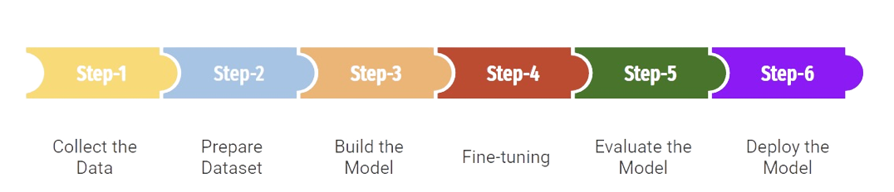

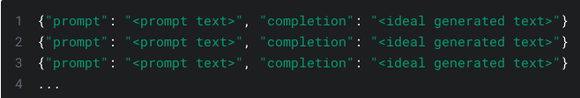
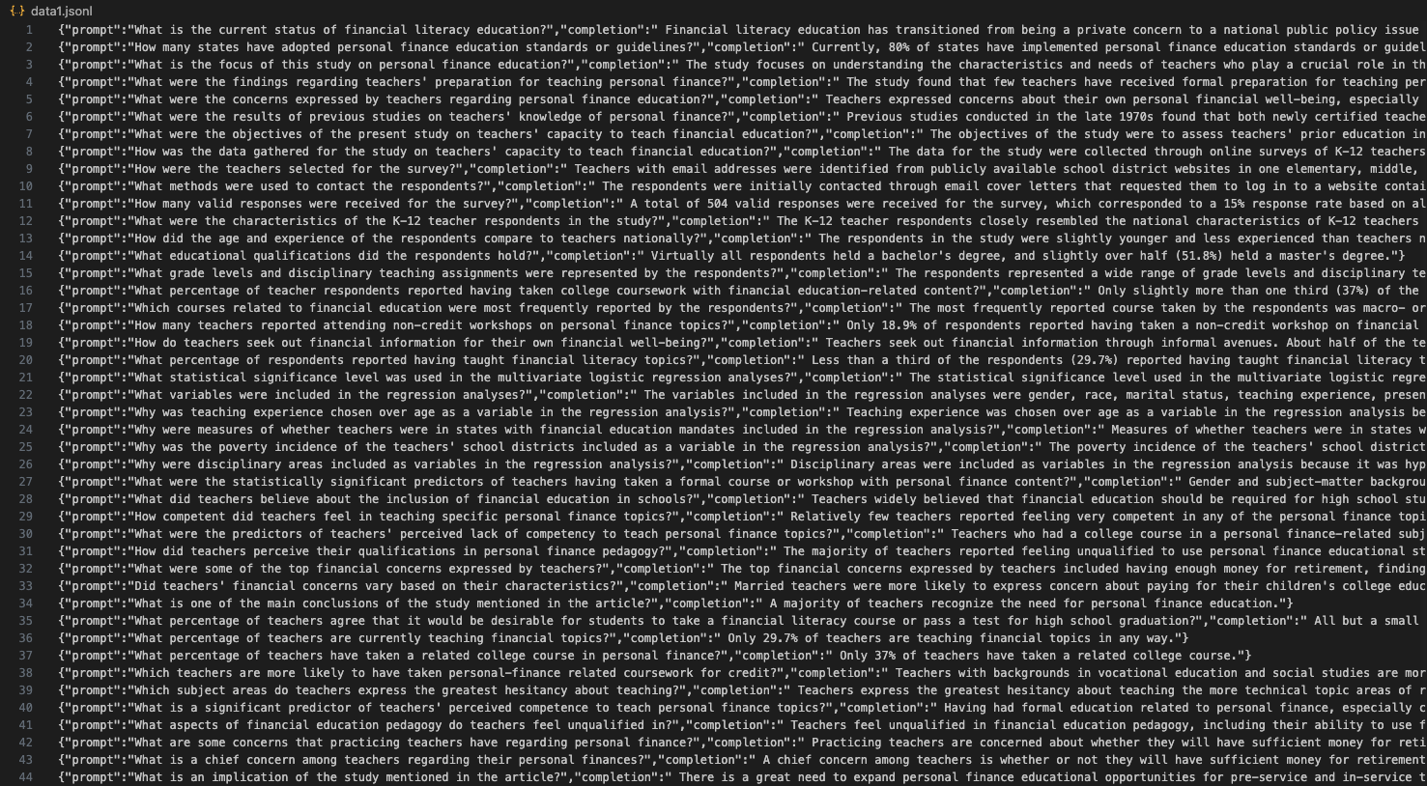
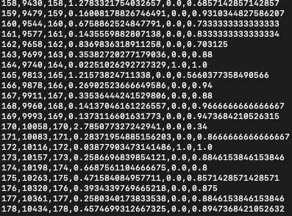
Our Approach
Fine Tuning
Model Selection
Benefits of using OpenAI
Time and Effort
Quality and Performance
Versatility and Generalisation

Slide 6
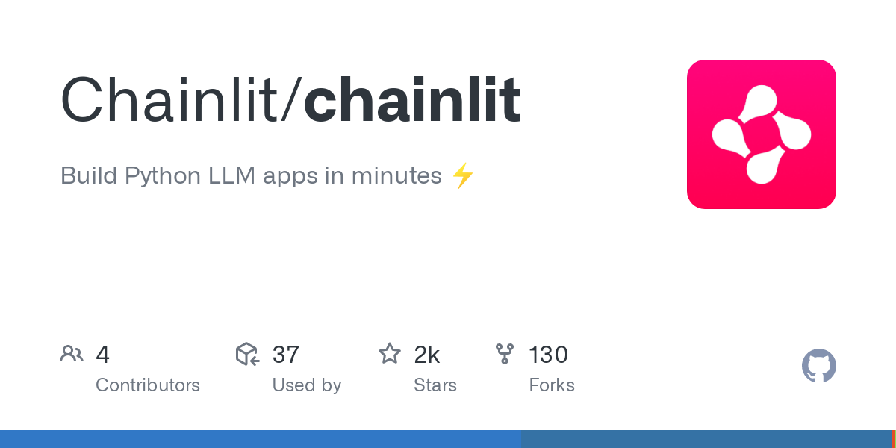
User Interface
For UI experience, we employed ChainLit library as it provides seamless integration of LLM model with ChatGPT like interface.
Why we love ChainLit for this Project?
Easy Integration
Features at our disposal
Better User Experience

Slide 7
Live Demo - 1
File Name: 2009 Outstanding AFCPE® Conference Paper
File Type: Research Paper
File Format: PDF
Qualitative question
who are the main authors of this paper?
Table based question
what are the NEFE Sample % of all race/ethnicity?
Narrative question
summarize the methodology.

Slide 8
Live Demo - 2
File Name: Capgemini integrated Annual Report 2022
File Type: Financial Report (k-10)
File Format: PDF
Quantitative questions
what is the average age of employees?
How much is the organic free cash flow?
Qualitative questions
what are the seven values?
Graph based question
revenue growth by country
Off guard questions
Tallest building in the world

Slide 9
Future Prospects
Implementation on Data Privacy and Security (As proposed in Solution architecture)
Improvement of Graphical Data Identification and Representation
Implement Reinforcement Learning based on User Response
Possible User Response : From 1 - 5 where, 1 being unsatisfied and 5 being Satisfied with desired output.

Slide 10
Q/A Session

